Slide 1
Mon.2024
Total Save Cost : 21.4kUSD / Year
Total Save Time : 15,868Hours / Year
Total : 10 ideas
Quality : 1 ideas ( Slide: 1 )
Cost : 2 ideas ( Slide: 2 ~ 3 )
Efficiency : 6 ideas ( Slide: 4 ~ 9 )
Safety : 1 idea ( Slide: 10 )
Notes:
GM, everyone! My name’s.
On be half of QCD, I’d like to present about improvement report.
Totally, we have 10 ideas including quality 3 ideas, cost 1 idea, efficiency 4 ideas and 5S3T 1ideea
After improvement, saved cost more than 86K USD, 1.2K hours.
Details for each idea will be shown more clearly on next pages.

Slide 2
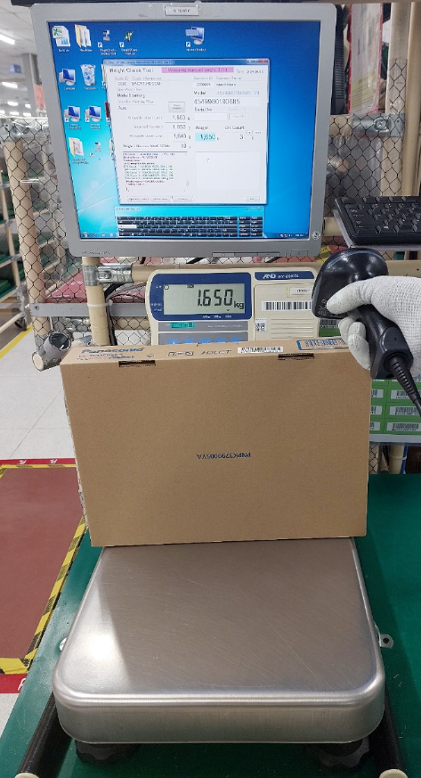
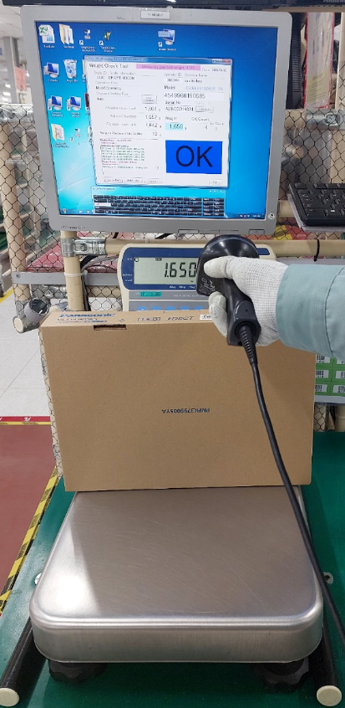
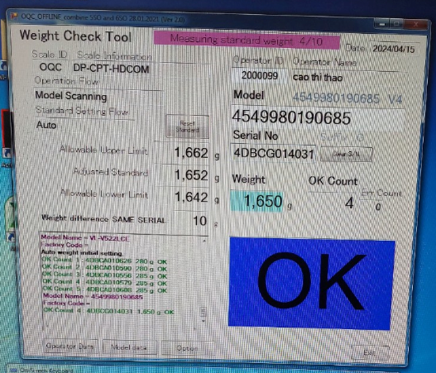
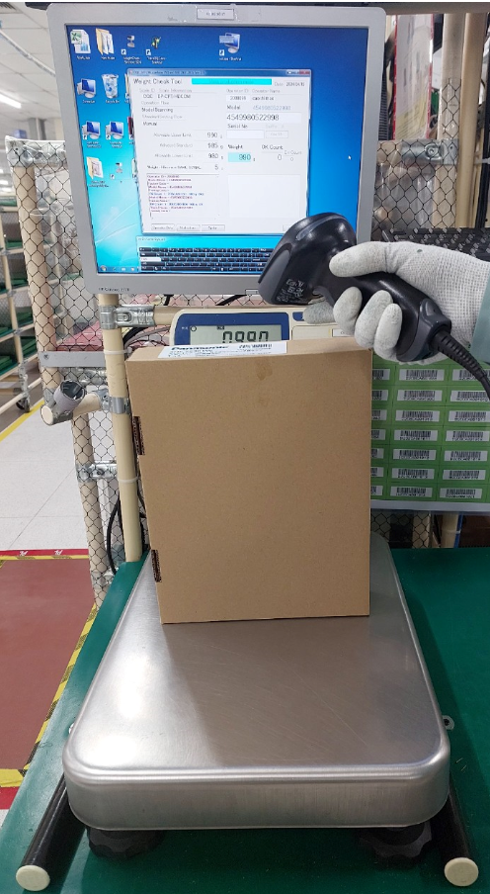
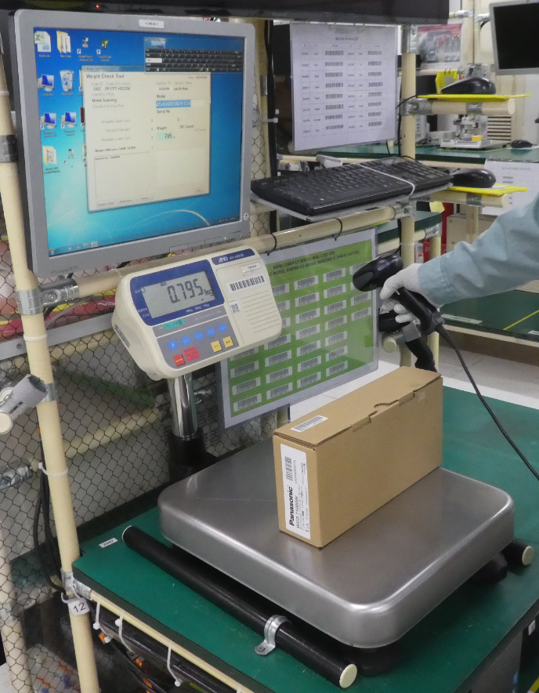
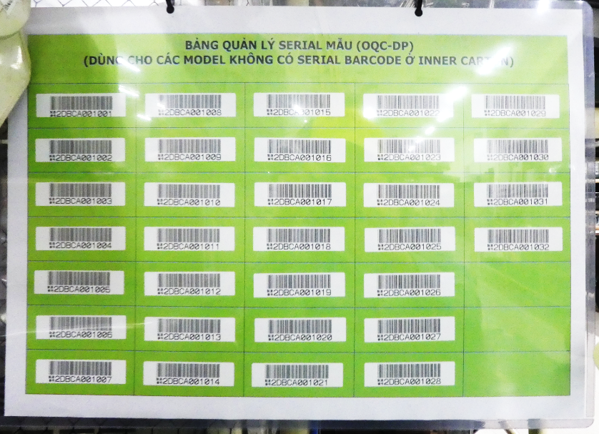
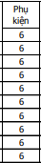
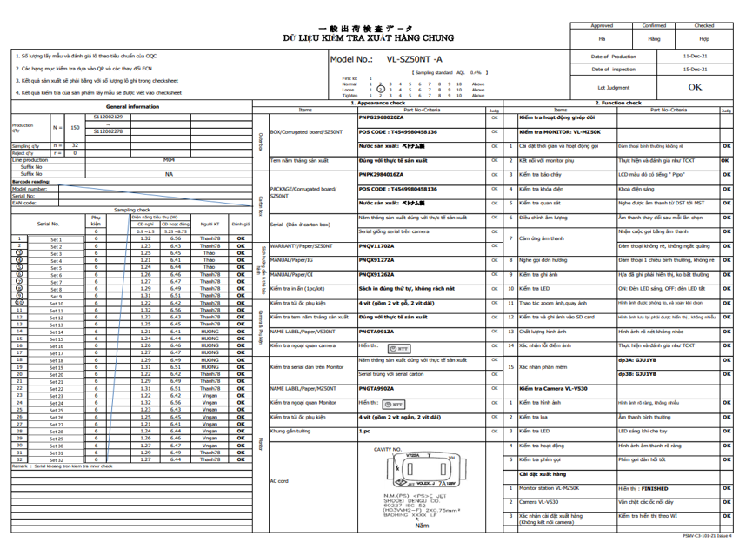
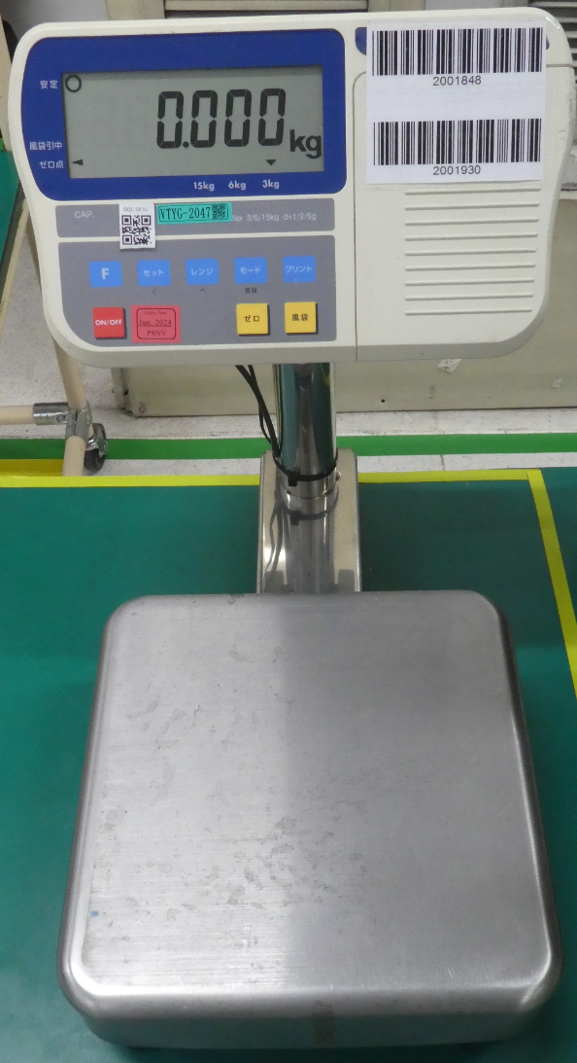
Quality
Section : OQC-DP
PIC: Nguyen Thi Bich Hop
Date: Apr/2024
Expn: 0 USD
Done
Control weight check for series model have not Serial No.
◆Before
◆ After
Control accessory at OQC inspection:
Improvement Control accessory at OQC inspection:
① Case 1: Model have serial No ➔ Control accessory by weight check
① Case 1: Continue applying control accessory by weight check
Reading POS code of product
Reading Serial of product
Weight check auto judgment OK
② Case 2: Improve weight check for product not have serial No
➔ Assign Dummy serial No to carton box
Control accessories by weight check
Reading POS code of product
Reading Dummy Serial no.
Using Dummy Serial No.
Weight check Auto judge OK to control accessory
② Case 2: Model have NOT Serial No ➔ Control accessory by manual
(350 models)
Control accessories by manual check sheet
Cannot weight check
Model not have serial No : 350 models
If not control weight check have risk missing accessories
Ship out bad product to customer make reduce company
reputation and caused Quality loss
Using dummy Serial No. to control 100% by weight check for product which not Serial No → To prevent missing accessories

Slide 3


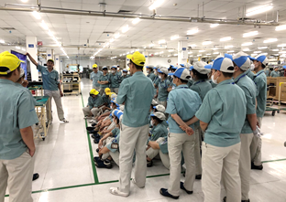
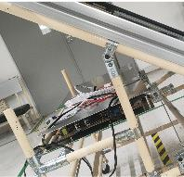
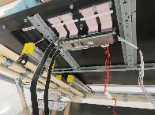
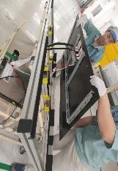
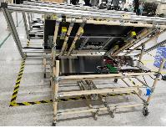
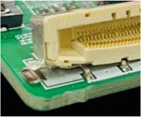
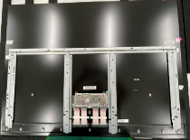
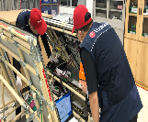
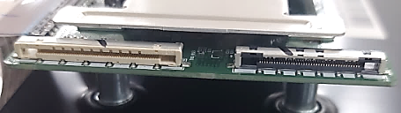

Cost
Section : IQC-TV
PIC: Thai
Date: Nov.23
Expn: 0 USD
Finished
Improving peel off T-Con PCB on Panel part → Reduce scrap Cost of part
◆Before
◆ After
Happen T-con of panel TV NG (broken)
→ must scrap panel under PSNV cost
PSNV must take action to improve ( IQC / FA/LGD)
IQC training
FA Made stopper fix jig & prevent NG
Stopper to prevent forget remove cable
LGD
MCS (PSNV)
FA process
OQC
Cause 1:
Cause 2:
➔ From Nov.23 ~ No happen NG again
Discuss LGD to Swap change T-con & re-write data
Panel OK
Panel NG
Jig fall down
Forget remove cable
Peel off CN
of T-con
Must scrap
all panel
T-Con PCB NG
T-Con PCB OK
Save: 11pcs Panel ~ 12.4 KUSD
PSNV FA process method of operation not good → Peel off T-con PCB on Panel part→ Must scrap panel under PSNV’s cost
Total NG q’ty FY23: 11pcs → loss cost: 12.4K USD if scrap
Training & Advise FA process improve method: Zero NG
Save cost of scrap panel under PSNV’s cost Δ12.4K USD

Slide 4
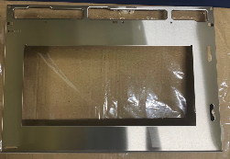
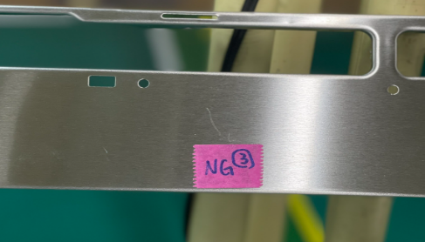
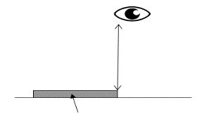
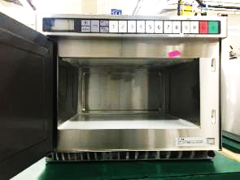
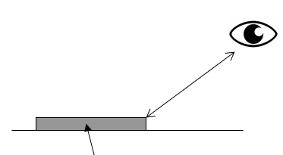
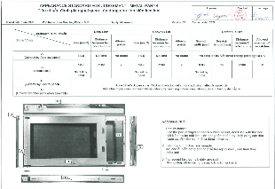
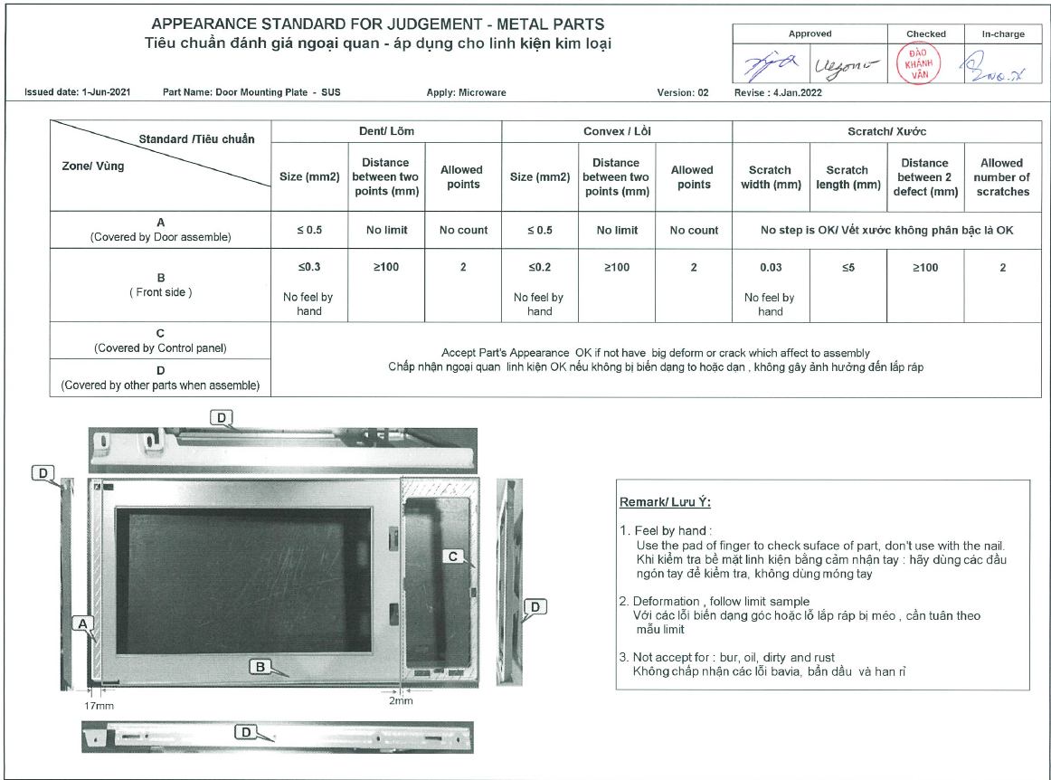
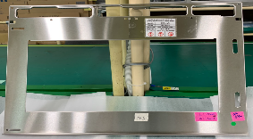
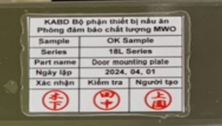
Cost
Section : IQC-MW
PIC: Huyen
Date: Mar.24
Expenses: USD
Continue
Reduce cost scrap part by review appearance standards judgment
◆Before
◆ After
PSNV suggestion revise STD as customer view
Metal part happen many appearance defect
. Change view
angle
. Same as
customer view
condition
60cm
Can not see if close the door
90º
60cm
Part
Base on KABD/ PAPMOHS, actual sample
➔ PSNV making standard & KABD approval
( Ver 1- FY22)
View 90º/60cm
As customer view
45º
. Proposal sample
. Send sample to
KABD to confirm
. Revise standard
(Version2)
➔ KABD approval
Part
View angle 45º/60cm
Total Reject Metal NG part /FY23 : 3K pcs
PSNV apply new standard to recheck
➔ NG q’ty Δ50% from 3Kpcs → 1.5Kpcs
PSNV judgment as KABD’s appearance standard issued
Part NG but maker don’t accept due common part used with PAPMOSH but never market claimed
➔ Scrap Cost by PSNV → High loss cost : 3Kpcs ~ 18.6K USD
4 parts already completed and recheck stock FG
➔ NG q’ty Δ1.5K pcs ~ Save cost: 9K USD
Total have 41 part appearance ➔ will review until Dec.24
( OCS model have 19 part / Oct.2024
18L model have 5 part – Nov.2024 and SCV model have 17 part – Dec .2024)

Slide 5
Efficiency
Section : IQC
PIC: Loan
Date: Mar.24
Expn: USD
Continue
Reduce IQC checking time of PL part by change checking method
◆Before
◆ After
IQC sampling checking follow rule below :
PSNV suggest Ranking PL part & Change method
Part come PSNV | IQC Check | 1 ~8 Lots | From Lot No 9th | Remark
Normal part | Check Actual part | Yes | Non | Return check if have trouble
PL part | Check Actual part | Yes | Yes | Every lot must check by 2 method
 | Check Maker’s CoC | Yes | Yes
Action:
Schedule & result ( 31.Mar):
Meeting & Negotiate with BU/BD by standard
Review actual maker's data condition
If continue apply rule for PL part ➔Loss Time
➔ Need discuss with BU/ BD to ranking for PL part
BU/BD side confirm final
Change checking method:
+ Check maker data
+ Check actual part
* MEBD & ISBD under discuss
Delete
Total PL Part / All BU : ~700 part
Average Coming lot / Month : 435 lot / month
Total checking time for PL part: 960H/ month
Checking time after change method : 800h/Month (9,600H/year)
Save HC for checking Δ 0.5pax

Slide 6
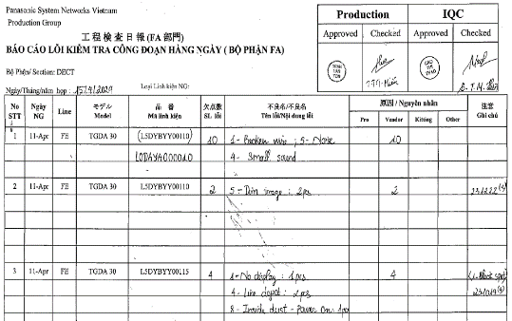
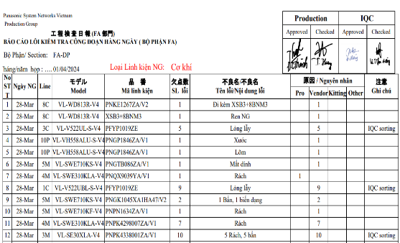






Efficiency
Section : IQC
PIC: Lan
Date: Mar.24
Expn: USD
Finished
Reduce working time to confirm NG part in Production by change method
◆Before
◆ After
Manual control when happen part NG on process
Auto control by soft copy & VBA system
Step 1
Step 1
Part NG on process
Part NG on process
Step 2
Step 2
FA write by hand
Make NG list
FA Input excel file
NG list
Manual writing
Soft file
Step 3
Step 3
IQC Manual confirm & approve NG part
FA & IQC confirm & approve in soft file
IQC writing VBA program
Step 4
Easy mistake by manual method.
Working time 5H/ day ~ 1,440H/ year
Step 4
IQC Manual input to excel to make report
Auto summary the IQC report
Exactly data by automation.
Working time 3H/day ~ 864H/year
FA manual writing part defective information in hard copy
IQC manual confirm and making daily part NG report
It is easy mistake & lost time (1,440H/ year)
FA input excel file for part defect information.
IQC confirm & auto making daily part NG report by VBA
It is exactly data and save time: 576H/ year (Δ 0.25 Pax)

Slide 7
Efficiency
Section : OQC-TV
PIC: Mai Thi Hang
Date: Mar/2024
Expn: 0 USD
Done
Skip duplicated items between Normal OQC & OBA [ OBA: Out of Box Audit (Request of Amazon) ]
◆Before
◆ After
New model : Normal OQC item & OBA item separate
Reduce duplicated items between OQC Normal & OBA
Inspection follow Amazon
PSNV
Amazon
Appearance check
<30 mins>
Discuss Amazon: If same method of inspection, Judgment → Reduce double checking item
Normal OQC check
<120 mins>
Item | OQC | OBA
Item | 24 | 20
Duplicated item | 16 | 16
OBA item check
<90 mins>
Reduce duplicated items
<Before>
<After>
Packing check
<30 mins>
Example: Duplicated item
Item | OQC | OBA
Item | 24 | 20
Item | OQC | OBA
Item | 24 | 4
OOBE
AIV test
HDMI connection Test
Headset Test
Button Test, Netflix test, ...
Shipment process
OBA item check : △16 items
Total function check Lead time : 210 mins/pc
➔ Loss time : 210mins *7pcs = 24,5H/day ~ 7,056H/year
(~3pax)
Total lead time reduce : 80mins/pc (5mins/1item)
➔ Save time : 80mins *7pcs = 9.3H/day ~ 2,668H/year
(Δ 1.16pax)

Slide 8
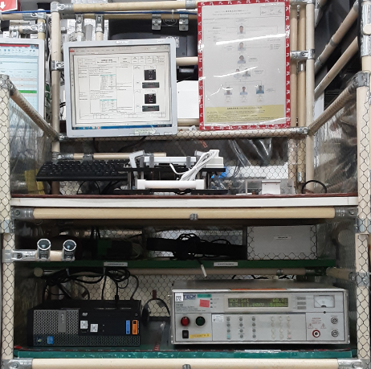
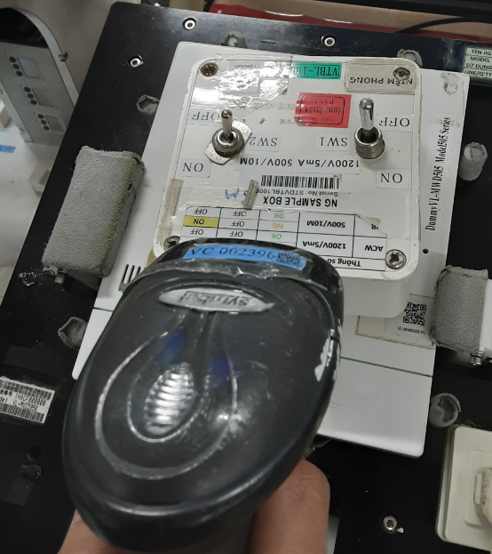
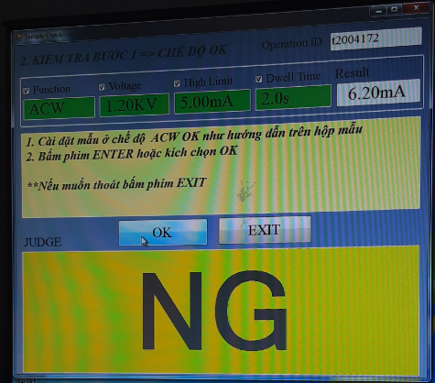
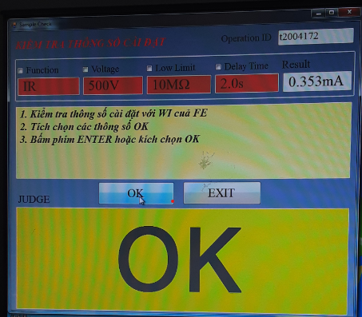
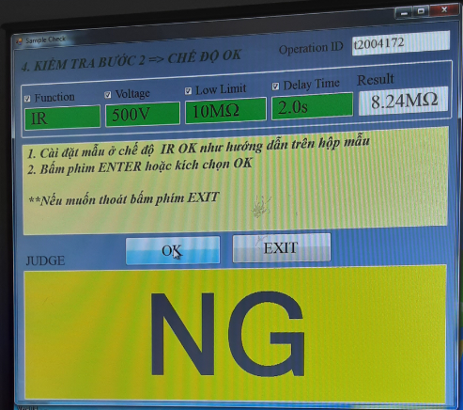
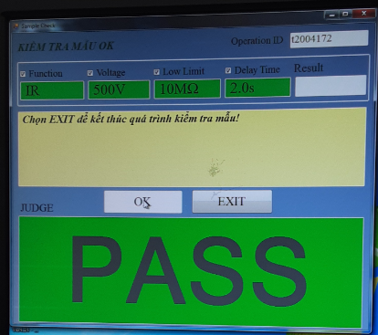
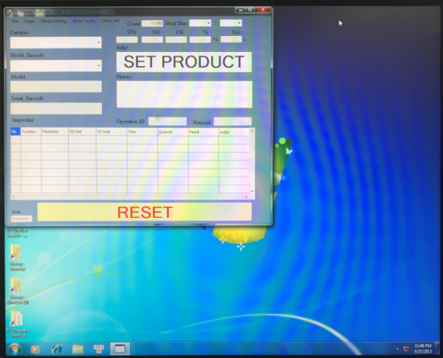
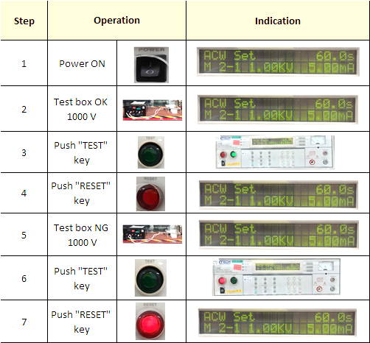
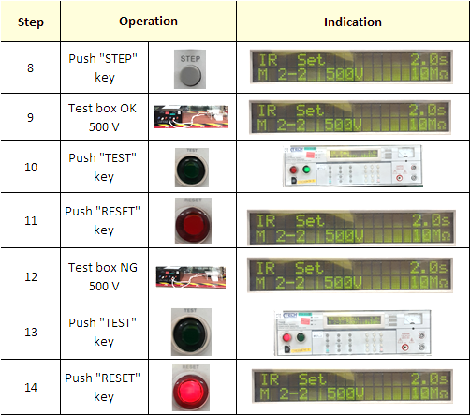
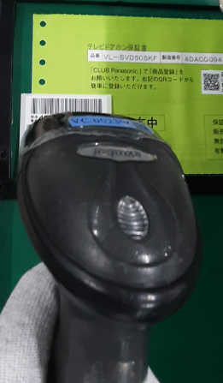
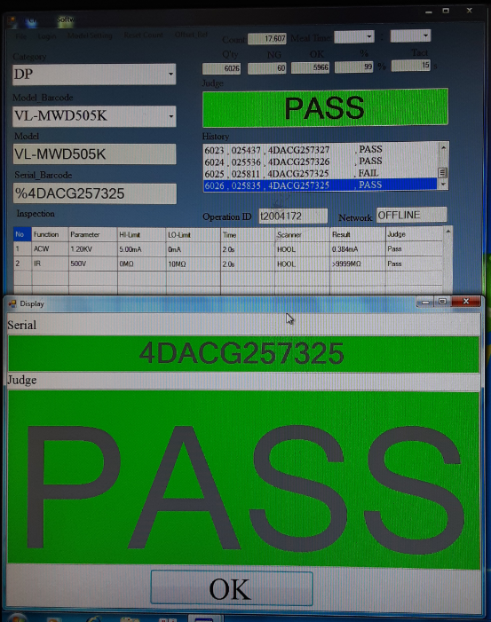
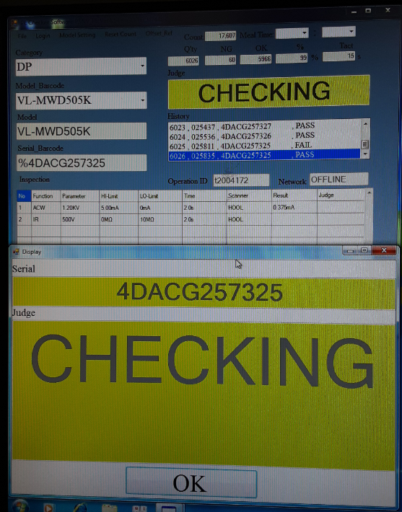
Efficiency
Section : OQC-DP
PIC: Nguyen Thi Bich Hop
Date: Apr/2024
Expn: 0 USD
Done
Change method check PL from check by Manual to Automation
◆Before
◆ After
Operation checking PL by manual
Operation checking PL by Auto
PL check process at OQC
Auto select program & Judgment
① Check Box
② Check product
① Check Box
“Insulation resistance”
Read QR code of Box
“Dielectric strength voltage”
“Insulation resistance”
“Dielectric strength voltage”
“Insulation resistance”
“Dielectric strength voltage”
Manual
Select program
Manual
Select program
Manual
Select program
Manual
Select program
② Check product
Read Barcode of Product
“Dielectric strength voltage”
“Insulation resistance”
All operation choose program & checking PL by manual
Easy select wrong program
Loss time to operation
Schedule
BU/BD | KABD | MEBD | VSBU
Horizontal Apply | May.24 | May.24 | Jun.24
Select program check PL by manual (Step by step) → Have risk: select wrong program
Loss time: 3min*1pc/lot~3*40pcs/40lots/day~2880min/month~ 48H/month (576H/year)
Checking PL auto to prevent mistake program check product
(Auto select PL program by reading Model barcode of product)
Loss time: 1.5min*40pcs ~1440mins/month~ 24H/month (288H/year)
Save time: 576-288=288H/year (Δ 0.13pax)

Slide 9
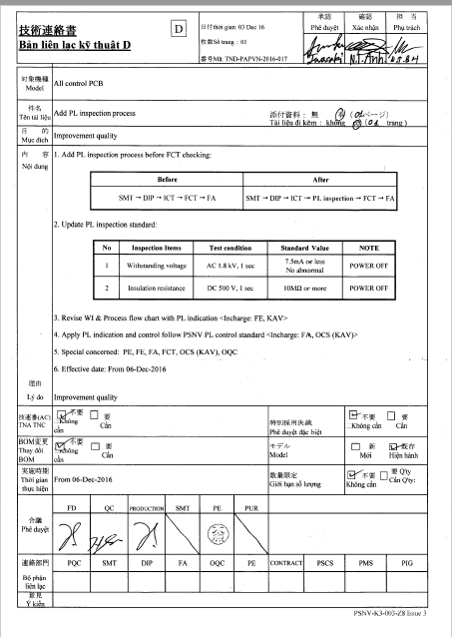
Transfer PL inspection step of FCT line to OQC (PAPVN)
Efficiency
Section : OQC-PAPVN
PIC: Nguyen Xuan Tung
Date: Apr/2024
Expn: 0 USD
Done
◆Before
◆ After
Add PL process from 6.Dec.16 to control SA part broken
SMT
PL
FCT
FA
OQC
From Dec.16: No happen SA part broken happen
SMT
PL
FCT
FA
OQC
Skip this process
Transfer PL inspection to OQC checking
Before
After
Production un-balance capacity of FCT & FA line
Check PL process at FA 100%
Loss time : 12,000 min/month
Balance capacity of FCT & FA line
Check PL process at QC sampling check
Loss time : 720 min/month
Current Situation :
Original did not have PL inspection process before FCT
PAPVN not request check PL before FCT checking
From Dec.16 have TND add PL inspection 100% control SA part
➔ Loss time: 15s/pcs
➔ Daily FCT process cannot ensure production plan
Improvement Point :
Transfer PL process to OQC sampling check
OQC: Sampling check 5pcs/lot/day
➔ Loss time: 5*6mins*24= 720mins/month
➔ Save time: 12,000-720=11,280mins/month (2,256H/year)
(Δ 1pax) (FCT process reduce loss time to up capacity daily)

Slide 10
Efficiency
Section : OQC-MW
PIC: Vu Thu Ha
Date: Mar/2024
Expn: 0 USD
Done
◆Before
◆ After
Order of Convection/Grill inspection
Re-arrange testing order to reduce redundant inspection items
OQC Inspection order
Loss time
OQC Inspection order
①
Aging→ Convection test
<10mins>
①
Aging → Convection test
<10mins>
②
Test Grill / Convection
<30mins>
⑥
Preheating → Input current max test
<△10mins>
③
Product cooling
<30mins>
Total reduce time: 50mins
③
Product cooling
<△30mins>
④
Preheating → Pizza plate test
<10mins>
④
Preheating → Pizza plate test
<△10mins>
⑤
Product cooling
<30mins>
⑤
Product cooling
<30mins>
⑥
Preheating → Input current max test
<10mins>
②
Test Grill / Convection
<30mins>
Preheating: Make Oven temperature reaches 280 degree
Cooling : Make oven temperature reaches room temperature
Change inspection order and reduce step ③- ( Cooling product )
Save time Preheating & make product cooling
SCV full function check:
Total lead time : 540 mins / pcs
Loss time : 540*2pcs ~ 18H / Day ~432H/ Month ~5184H / Year
Reduce redundant inspection items
Total reduction after change order of checking item : 50mins/pcs
Using time : 490mins*2pcs ~ 16.3H / Day ~392H/ Month ~4704H / Year
Save time: 5184 – 4704 = 480H/year (Δ 0.3pax)

Slide 11
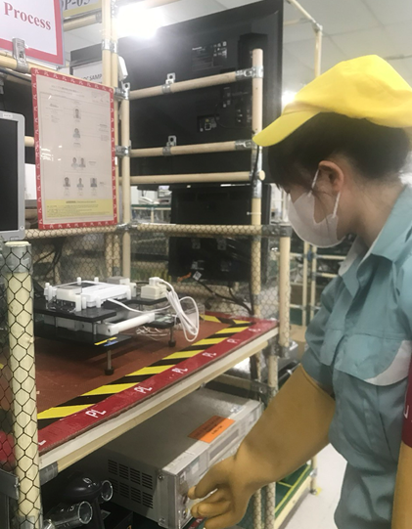
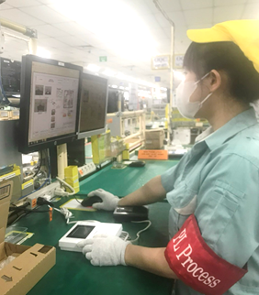
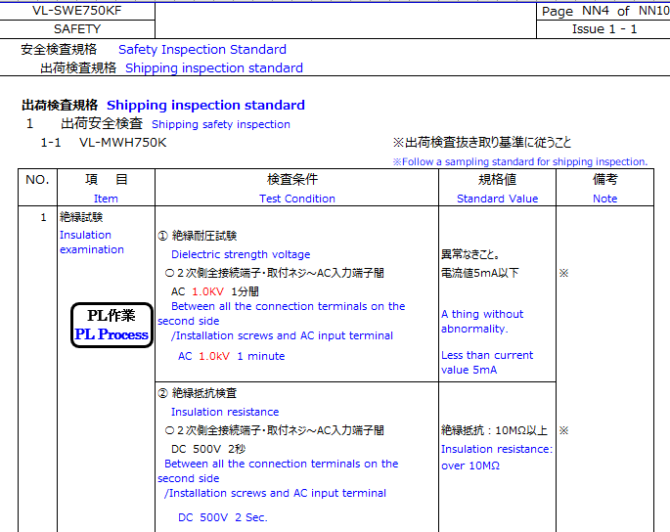
Efficiency
Section : OQC-DP
PIC: N.T.B.Hop
Date: Aug/2024
Expn: 0 USD
Done
◆Before
◆ After
Current OQC PL inspection: <1pcs/lot/model>: 2 times Full function check
Reduce item check before PL inspection: Full function check 1 time
FA
OQC
<1 time>
FA
<1st time>
OQC
<2nd time>
F/G
sample
Basic confirm function
PL check
FULL Function check
F/G
sample
FULL Function check
PL check
FULL Function check
[Reduce item before PL check]
[Full function Before & After PL check]
Basic function to confirm product
1. Clock setting Backup inspection
2. Sub Monitor Registration
3. Movement inspection of "Door station"
~ ………………………………
30. Shipping setup
Full check
30 items
Leadtime
30 mins
Full function check item: 30 items
1. Clock setting Backup inspection
2. Sub Monitor Registration
3. Movement inspection of "Door station"
~ ………………………………
30. Shipping setup
Leadtime
18 mins
NEW
Review PDS for PL inspection:
Item: [3. Movement inspection of "Door station“]:
Confirm product power ON : OK
Image quality : OK
Communication : OK
➔ Ensure product OK before PL check
PDS not require check full function before PL
PDS
Current OQC PL inspection: <1pcs/lot/model>: 2 times Full function check
Loss time: 25 lots*30mins=750mins/day ~12.5H/day
Reduce item check before PL inspection: Full function check 1 time
Save time: 25 lots*12mins=300mins/day ~5H/day ~ 0.6pax/day

Slide 12
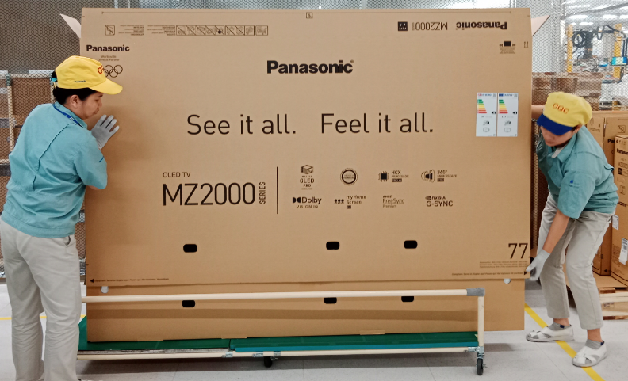
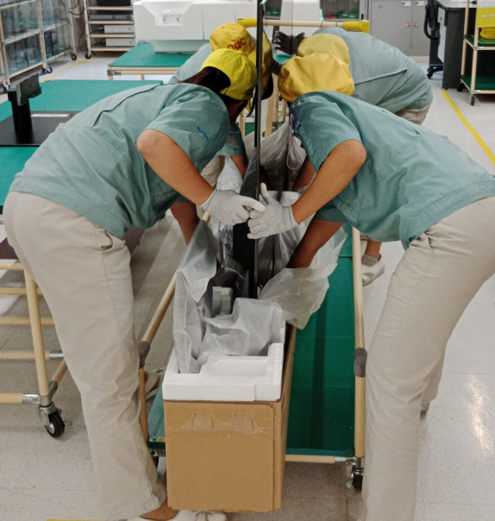
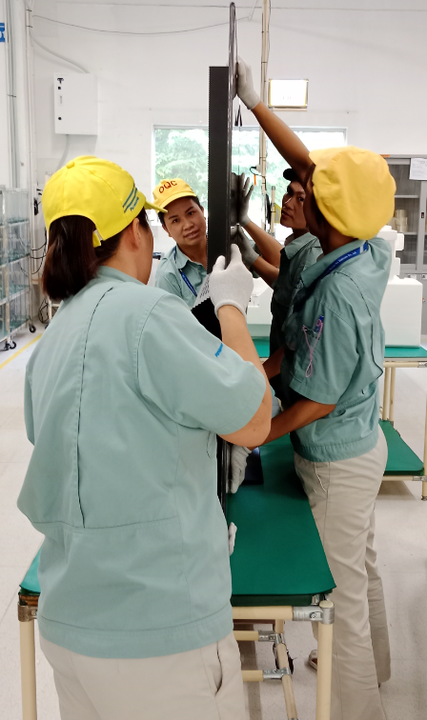
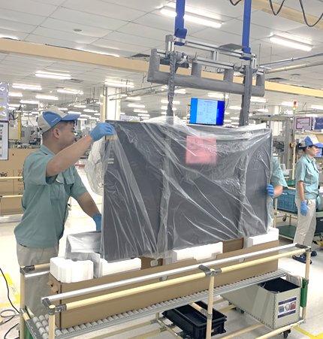

Safety
Section : OQC-TV
PIC: Mai Thi Hang
Date: Mar/2024
Expn: 0 USD
Done
◆Before
◆ After
Pick up heavy product of TV & MW
Common using Pick up machine with FA process
FA
OQC
SCM
FA
OQC
FA
SCM
Back-ache
MZ2000 series: 62kg
Need 4 operators to packing
Packing & Repacking by Manual: Heavy product
➔ Dangerous for operators
Packing & Repacking by machine on FA process
➔ Safety for operators
OQC pick up heavy sampling by manual → Risk:
Affect operator health
Product easy drop during pick up
Common using Pickup machine with FA process::
FA/PE: Training for OQC operator using method
Training about safety for all OQC operators

